Slide 1
Chapter 1
Introduction to PL/SQL

Slide 2
Introduction
PL/SQL stands for Procedural Language extensions to the Structured Query Language (SQL). SQL is a powerful language for both querying and updating data in relational databases.
Features of PL/SQL
PL/SQL is tightly integrated with SQL.
It offers extensive error checking mechanisms.
It supports numerous data types for flexible data handling.
Includes a variety of programming structures, such as loops and conditionals.
It supports structured programming through functions and procedures.
It supports object-oriented programming, enabling more complex data handling and manipulation.

Slide 3
Data Types
Scalar Data Types:
These represent single, indivisible values and include:Numeric Types: NUMBER, INTEGER, PLS_INTEGER, BINARY_INTEGER, DECIMAL, FLOAT, REAL, DOUBLE PRECISION, etc. (e.g., NUMBER(5,2) for a number with 5 total digits and 2 decimal places).
Character Types: CHAR, VARCHAR2, NCHAR, NVARCHAR2, LONG, RAW, etc. (e.g., VARCHAR2(100) for a variable-length string up to 100 characters).
Boolean Types: BOOLEAN (stores TRUE, FALSE, or NULL).
Date/Time Types: DATE, TIMESTAMP, TIMESTAMP WITH TIME ZONE, INTERVAL YEAR TO MONTH, INTERVAL DAY TO SECOND, etc.

Slide 4
Declare Variables in PL/SQL
To declare a variable in PL/SQL, use the DECLARE keyword followed by the variable name and its data type. Optionally, you can also assign an initial value to the variable using the ':=' operator.
DECLARE
variable_name datatype := initial_value;
variable_name: It is the name of the variable.
datatype: It is the data type of the variable.
:= initial_value: It is an optional assignment of an initial value to the variable.
Example:
DECLARE
name VARCHAR(20) := ‘Hello';

Slide 5
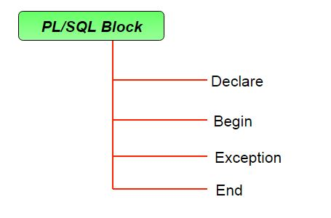
Structure of PL SQL

Slide 6
Structure of PL SQL
Declare section starts with DECLARE keyword in which variables, constants, records can be declared which stores data temporarily. This part of the code is optional.
Execution section starts with BEGIN and ends with END keyword. This is a mandatory section and here the program logic is written to perform any task like loops and conditional statements. It supports all DML commands, DDL commands.
Exception section starts with EXCEPTION keyword. This section is optional which contains statements that are executed when a run-time error occurs. Any exceptions can be handled in this section.

Slide 7
Structure of PL SQL
DECLARE declaration statements; BEGIN executable statements EXCEPTIONS exception handling statements END;

Slide 8
IF Statement
The if statement allows you to execute one or more statements based on a condition. PL/pgSQL provides you with three forms of the if statements:
if then
if then else
if then elsif
if-then statement
Syntax:
if condition then
statements;
end if;

Slide 9
IF Statement
if-then-else statement
Syntax:
if condition then
statements;
else
alternative-statements;
end if;
if-then-elsif Statement
if condition_1 then
statement_1;
elsif condition_2 then
statement_2...
elsif condition_n then
statement_n;
else
else-statement;
end if;

Slide 10
For Loop
Syntax:
FOR counter IN [REVERSE] start..end LOOP
-- statements
END LOOP;

Slide 11
while loop statement
Syntax
while condition loop
statements;
end loop;

